Slide 1
An Empirical Study on Oculus Virtual Reality Applications:
Security and Privacy Perspectives
2024 IEEE/ACM 46th International Conference on Software Engineering (ICSE)
Hanyang Guo, Hong-Ning Dai, Xiapu Luo, Zibin Zheng, Gengyang Xu, Fengliang He
Reporter: Zhengyang Zhu
July 2024

Slide 2
Research Background
Most VR operating systems (OS) are based on off-the-shelf mobile OS (e.g., Android). As a result, VR apps also inherit privacy and security deficiencies from conventional mobile apps.
VR market size grows
hardware and software has fastened the adoption of VR technology
proliferation of diverse VR devices
the increasing attention of the metaverse in recent years
little attention has been paid to the security and privacy issues of emerging VR apps
few studies on privacy policy analysis on VR apps
.....

Slide 3
OS-related Security and Privacy Vulnerabilities
Most VR operating systems (OS) are based on off-the-shelf mobile OS (e.g., Android). As a result, VR apps also inherit privacy and security deficiencies from conventional mobile apps.
Insecure Flag Settings (allowBackup, debuggable, and clearTextTrafiic.)
Dangerous Permission Usage (location, camera, microphone)
PII Data Leaks (user, name, password, email, and phone)
SQL Database Injection (SDI) (insert additional SQL statements , executing an un-authorized query)
Insecure certificate validation (ICV),
Insecure random generator (IRG),
Insecure Webview Implementation (IWI),
IP Disclosure (IPD),
Remote Webview Debugging (RWD),
improper encrypt functions (IEF),
insecure hash functions (IHF),
Root Detection (RD),
VR-related Tackers

Slide 4
VR-platform-related Security and Privacy Vulnerabilities
VR apps can achieve immersive experience via diverse VR devices, such as head-mounted displays, body sensors, and controllers though achieving this requires the extensive collection of privacy-sensitive human biometrics (e.g., hand-tracking and facetracking data).
Moreover, VR apps have been typically implemented
by 3D gaming engines (e.g., Unity), which also contain intrinsic security vulnerabilities.
New Permission Requests
Misuse of Human Biometrics (hand-tracking, eye-tracking, body-tracking, and face-tracking data)
In-App Purchasing (IAP) Vulnerabilities
VR-specific PII Data Leak
Privacy Policy Weakness

Slide 5
Methodology of VR-SP detector
a security and privacy assessment tool, integrated program static analysis tools and privacy-policy analysis methods
(1)App Collection
static analysis of theseVR apps is not affected by VR devices
consider only those free apps
(2)VR AppAnalysis
connect Oculus Quest 2 to the PC
install the app into Oculus Quest 2 via SideQuest
Androguard, an open-source Python tool(APK to configuration files,Dalvik bytecode, source code)
(3)Taint Analysis
(4)Privacy Policy Analysis
PolicyLint, transfers statement in the privacy policy to plain texts and takes them as input.

Slide 6
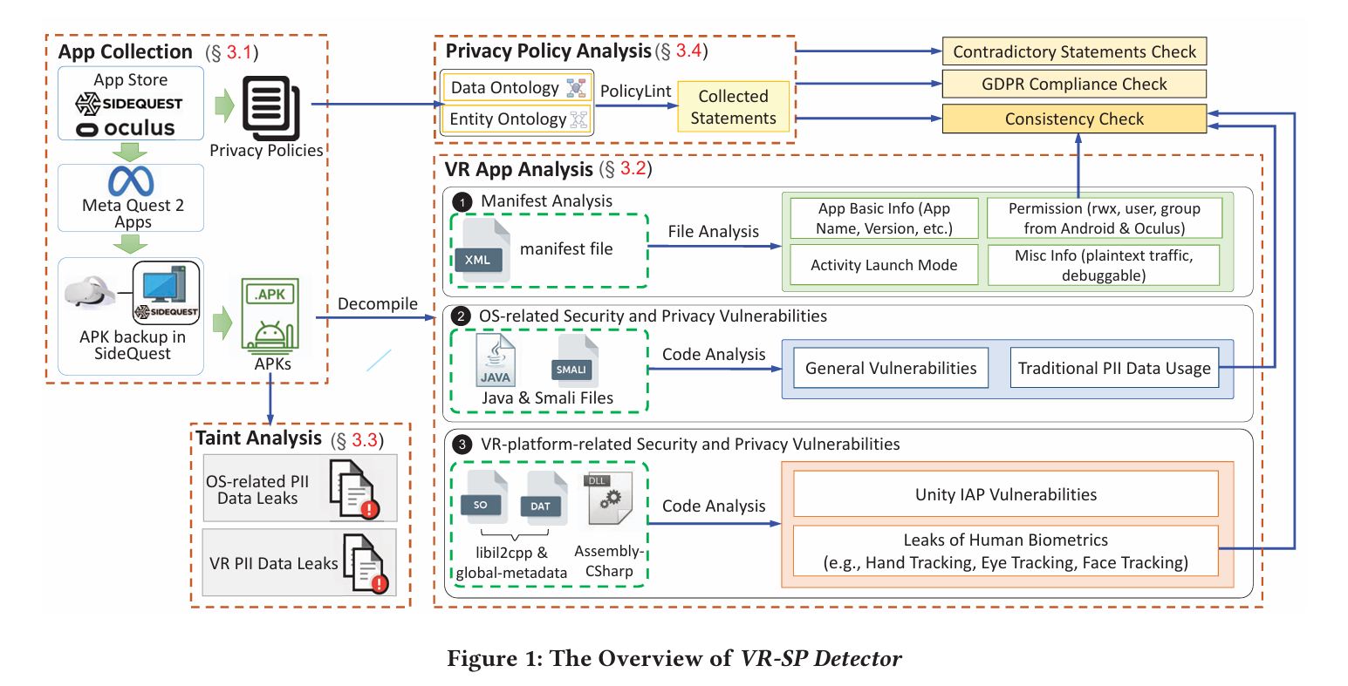

Slide 7
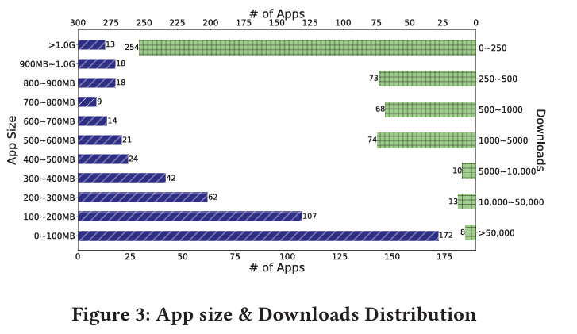
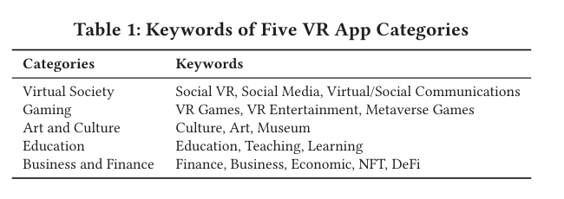
App Collection
collected 500 apps including 81 virtual social apps,149 gameapps, 115 art and culture apps,115 education apps,and 40 business and financea pps
many apps are less than 100MB, which may own to limited space in current VR devices.
most VR apps have been downloaded less than 5,000 times, implying that the development of VR apps is still in its early stage.

Slide 8
VR App Analysis
Manifest Analysis
app_name, package_name, version_code and sdk_version of the app
permission
activity launch mode ( singleTask may cause the task-hijacking vulnerability)
allow_backup, use_plaintext_traffic
Detecting OS-related Security and Privacy Vulnerabilities.
methods (functions) and strings from Java files (without detailed variable names and method signatures) and Smali files that include Dalvik bytecode from classes.dex
method signatures by using PII keywords, such as user, password, username, phone, id, and email to identify PII data usage
Identifying VR-platform-related Security and Privacy Vulnerabilities

Slide 9
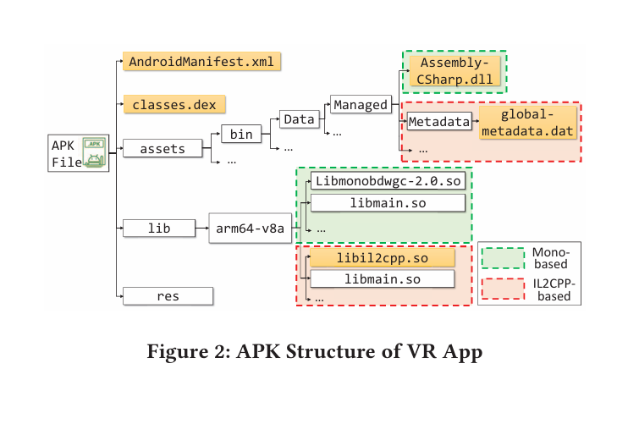
VR App Analysis
Mono-based: compile the C# code to .NET Common Intermediate Language (CIL) and use a Mono Virtual Machine (VM) to execute the CIL code at run time. (dnSpy)
IL2CPP-based: transfer CIL codes into C++ codes , compile C++ codes into native binaries.

Slide 10
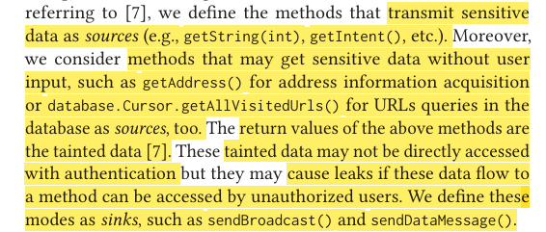
PII Data Leaks Identification
define source, sink(汇), tainted data
search the lifecycle and method callback in the activity to construct the control flow graph (CFG).
Based on CFG, we detect each defined source and taint the sensitive data. Then, we execute the data flow analysis to track the tainted data. If the tainted data flows from a source to a sink, we label it as a potential privacy-leak path
Privacy Policy Analysis
<entity, action, data type> PolicyLint
check whether there are contradictory statements
detect whether each privacy policy complies with General Data Protection Regulation (GDPR). GDPRWise
check whether their privacy policies have statements about the use of these sensitive data (check consistent with the app analysis results )

Slide 11
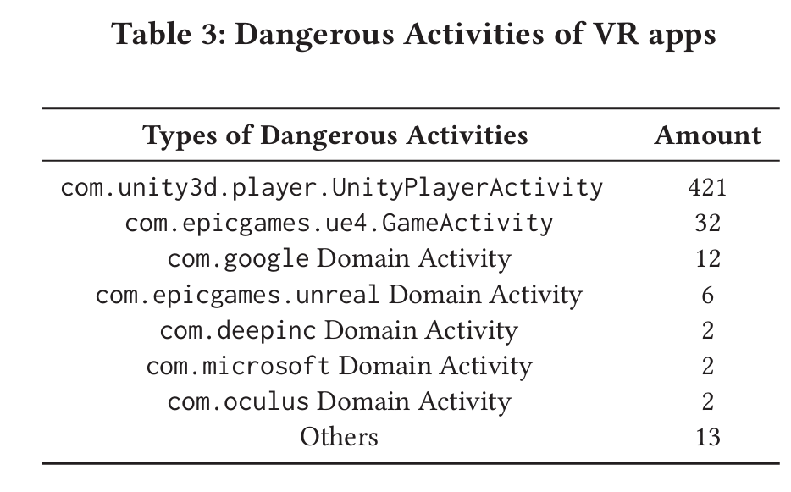
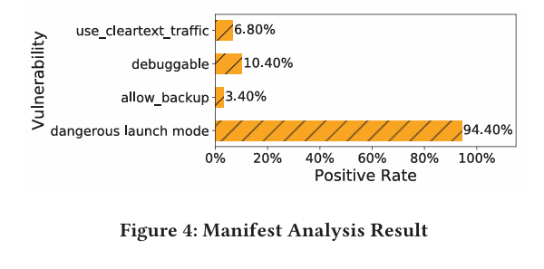
RQ1:What is the manifest vulnerability profile of VR apps?
94.40% of the VR apps have activities having dangerous launch modes
most of the activities are com.unity3d.player.UnityPlayerActivity since these apps are developed based on Unity.

Slide 12
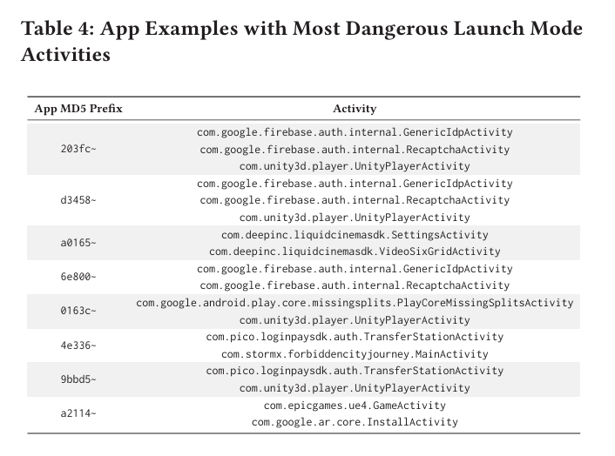
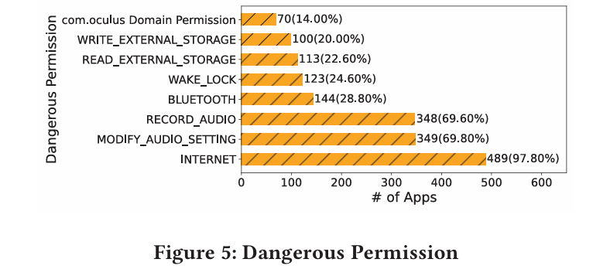
RQ1:What is the manifest vulnerability profile of VR apps?
most VR apps useINTERNET permission
Most of the VR apps have a dangerous launch mode and sound-recording. Some apps have backup, debug, and network traffic misuse.

Slide 13
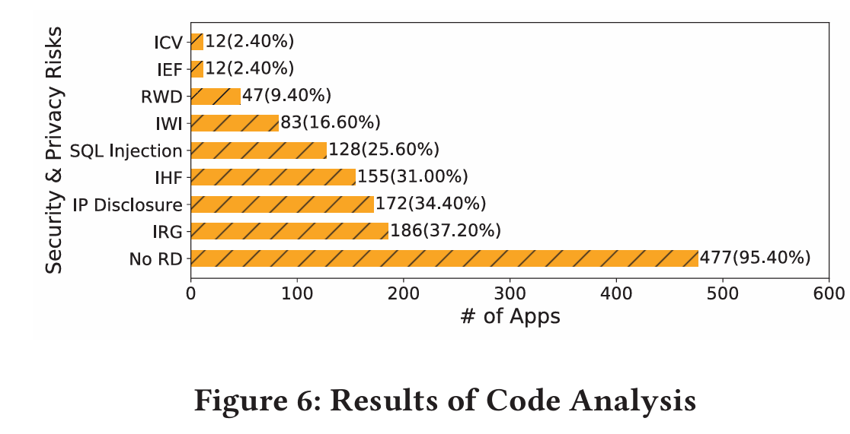
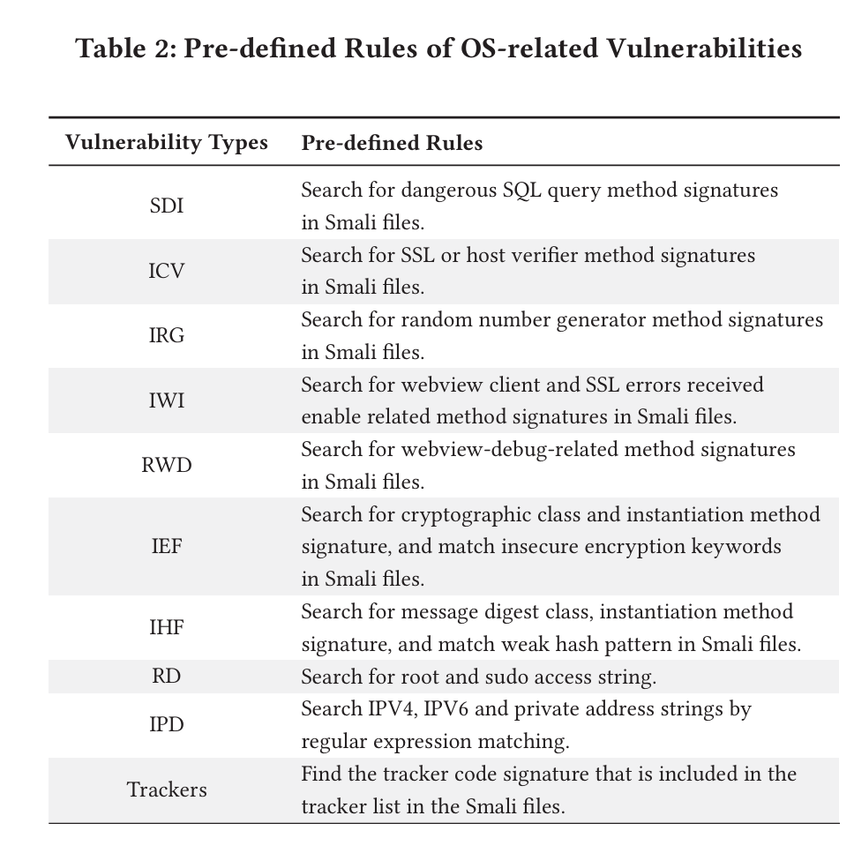
RQ2: What are VR apps’ major OS-related security and privacy vulnerabilities?
no-root detection vulnerability: leading to private information
leakage caused by accessing databases with root privileges.
random generators: cause private information (e.g., location) to
be tracked by speculating random numbers on critical functions.
IHF: Attackers can exploit IHFs to conjecture users’ input via
analyzing typing activities on virtual keyboard.

Slide 14
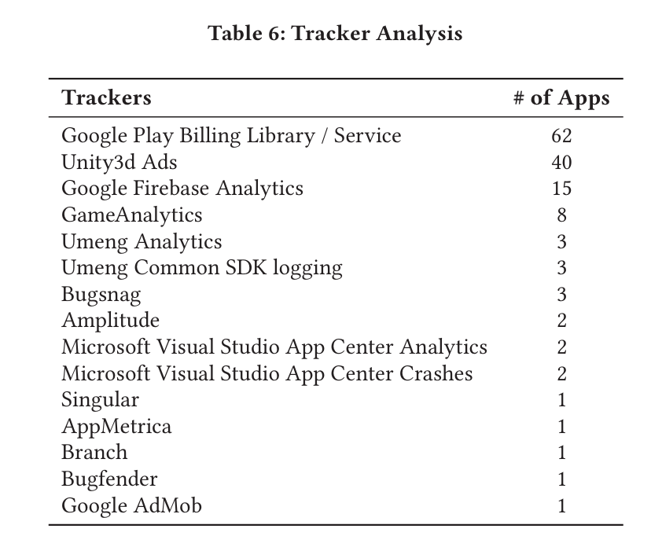
RQ2: What are VR apps’ major OS-related security and privacy vulnerabilities?
108 VR apps use trackers
expose users to the risk of privacy breaches (sharing sensitive data with distinct advertisers, such as Unity3d Ads )
Most VR apps have the no-root-detection vulnerability of VR devices.
A significant number of apps have used trackers.

Slide 15
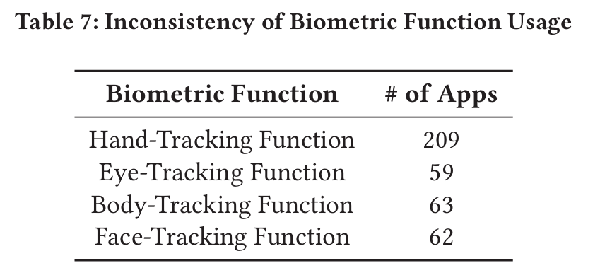
RQ3:What areVR apps’ major VR-platform security and privacy vulnerabilities?
Although only 5.60% of VR apps have used Unity IAP functions, all of them have IAP no-verification vulnerabilities.
49.12% of Unity VR apps have inconsistency between permission requests and biometric function usage, thereby causing leakage risks of human biometrics. ( adopting biometric data collection functions while having no permission requests in the manifest file.)
a significant number of apps do not adhere to the specifications of the Oculus VR app development documentation.

Slide 16
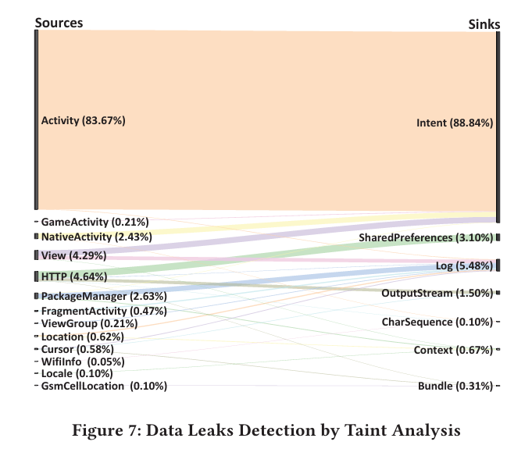
RQ4:To what extent is PII data leaked?
e.g.
data flow from Location method to registerReceiver() in content.Intent
The BroadcastReceiver registered with the registerReceiver() method is global and exportable by default. If access is not restricted, it can be accessed by any external app, passing Intent to it to perform specific functions. Therefore, dynamically registered BroadcastReceiver may lead to security risks such as denial of service attacks, APP data leakage, or unauthorized calls
A number of VR apps have the leakage risks of
PII sensitive data. Most data flow from activity-related methods to intent-related methods.

Slide 17
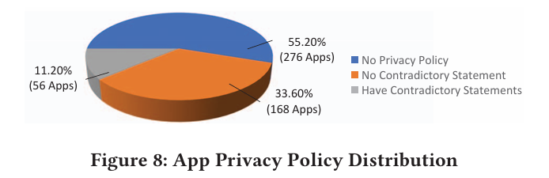
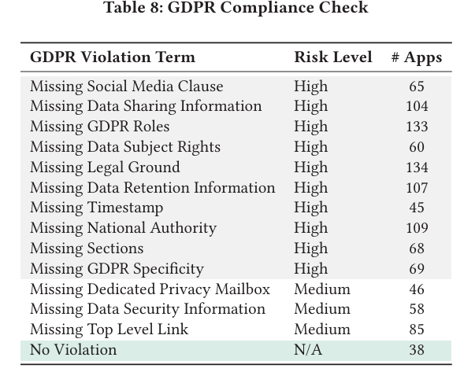
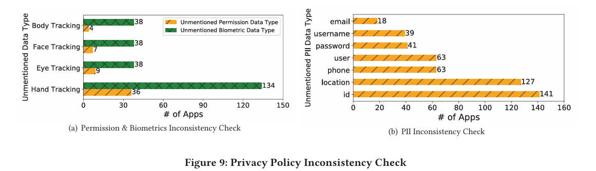
RQ5:HowdotheVRappdevelopers comply with the privacy policies?
a certain percentage of VR apps containing unregulated privacy policies

Slide 18
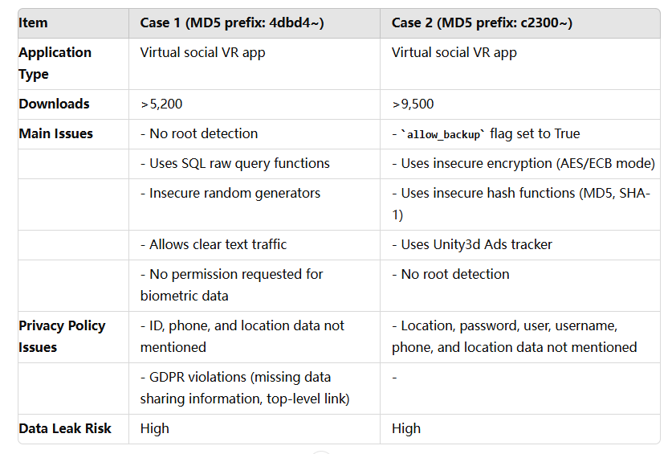
Case Study & Advices
Advice 1: Set proper secure flags in the manifest file. (set False: allow_backup, debuggable, and use_cleartext_traffic.)
Advice 2: Enable root detection when starting the VR app(Arooted device may cause the association of app data and user data,invaded malware lurking in the VR device can steal users’ private information. )
Advice 3: Do not use insecure hash functions/encryption algorithms (secure hash functions (e.g., SHA-256) and encryption methods, such as RSA with OAEP padding.)
Advice 4: Check data flows used by the trackers
Advice 5: Comply with permission requests to collect biometric data. (Developers should comply, app stores should strengthen code audits)
Advice 6: Adapt privacy policies to fulfill VR apps’ new features.

Slide 19
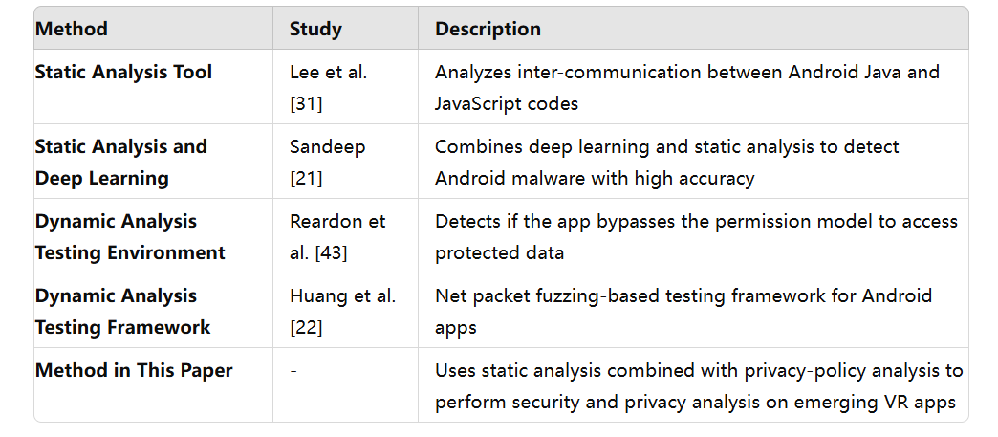
Limitations & Threats
cannot get the complete decompiled code
mainly focus on VR apps developed based on Unity / Meta Oculus Quest 2
GDPRWise found 9 false positives while detecting the compliance with GDPR
non-English language
PDF format, which is not supported by the service
additional external links
Related Work : Program Analysis

Slide 20
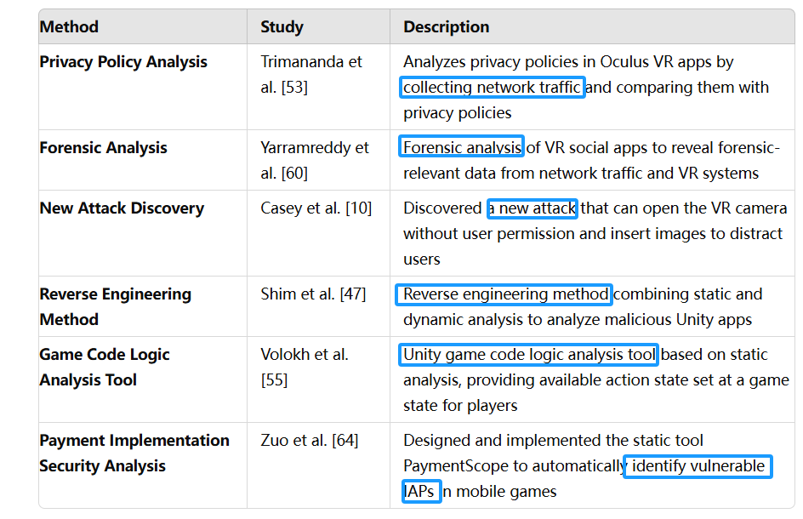
Related Work : Security and Privacy Analysis of VR Apps / Unity-based App

Slide 21
Conclusion & Questions / Recommendations
Using VR-SP detector, we have conducted the security and privacy assessment of 500 popular VR apps.
Our analytical results have revealed important security and privacy issues of existing metaverse-related VR apps. Based on our findings, we have made development recommendations for future VR apps with security and privacy preservation. (to Developers, App Store, Legal Apsect)
Using some open source tools: dnSpy, Androguard, PolicyLint, GDPRWise
Deeped Discussion with other related work, which is helpful for my future study
After reading the empircal study part 4, i have a better understanding on how to display the results of study ( i used to ...)
When it comes to some terms like task-hijacking, activity launch mode, reading the reference can answer my doubts....
How long did the whole work take?
Is necessary to show the detailed process of how to analysis the VR Apps by using those open source tools, especially Androguard and dnSpy, and the process of Taint Analysis?
( maybe it can be more convincing)
can access the source code, as well as some method / functions signatures by Androguard?

